Slide 1
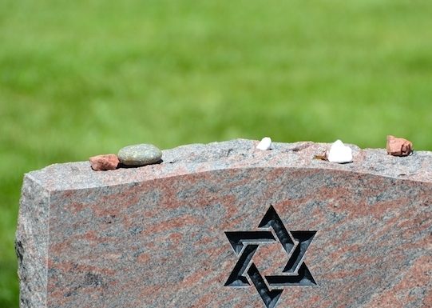
Jewish Death and Mourning Traditions
With Rabbi Lori Cohen

Slide 2
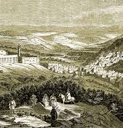
From the time of the Torah…
א וַיִּֽהְיוּ֙ חַיֵּ֣י שָׂרָ֔ה מֵאָ֥ה שָׁנָ֛ה וְעֶשְׂרִ֥ים שָׁנָ֖ה וְשֶׁ֣בַע שָׁנִ֑ים שְׁנֵ֖י חַיֵּ֥י שָׂרָֽה: ב וַתָּ֣מָת שָׂרָ֗ה בְּקִרְיַ֥ת אַרְבַּ֛ע הִ֥וא חֶבְר֖וֹן בְּאֶ֣רֶץ כְּנָ֑עַן וַיָּבֹא֙ אַבְרָהָ֔ם לִסְפֹּ֥ד לְשָׂרָ֖ה וְלִבְכֹּתָֽהּ: ג וַיָּ֨קָם֙ אַבְרָהָ֔ם מֵעַ֖ל פְּנֵ֣י מֵת֑וֹ וַיְדַבֵּ֥ר אֶל־בְּנֵי־חֵ֖ת לֵאמֹֽר: ד גֵּר־וְתוֹשָׁ֥ב אָֽנֹכִ֖י עִמָּכֶ֑ם תְּנ֨וּ לִ֤י אֲחֻזַּת־קֶ֨בֶר֙ עִמָּכֶ֔ם וְאֶקְבְּרָ֥ה מֵתִ֖י מִלְּפָנָֽי:
This was the life of Sarah - one hundred years, and twenty years, and seven years - the years of the life of Sarah. Sarah died in Kiryat Arba, which was Hevron, in the land of Canaan. Avraham came to mourn for Sarah and to cry for her. Avraham arose from before his dead and he said to the Sons of Chet, “I am a stranger, dwelling amongst you. Give me a holding for burial with you so that I may bury my deceased from before me.” (B’reishit 23:1-4)

Slide 3
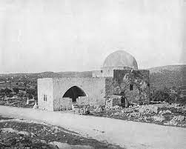
M’tzevah – Stone Pillar
Genesis 35:20
וַיַּצֵּ֧ב יַֽעֲקֹ֛ב מַצֵּבָ֖ה עַל־קְבֻֽרָתָ֑הּ הִ֛וא מַצֶּ֥בֶת קְבֻֽרַת־רָחֵ֖ל עַד־הַיּֽוֹם:
"Jacob set a pillar upon her grave: that is the pillar of Rachel's grave unto this day.“

Slide 4
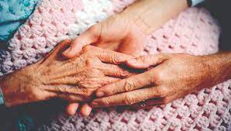
At the end of life…
Vidui – deathbed confession
Shema
Family members
וַיְכַ֤ל יַֽעֲקֹב֙ לְצַוֹּ֣ת אֶת־בָּנָ֔יו וַיֶּֽאֱסֹ֥ף רַגְלָ֖יו אֶל־הַמִּטָּ֑ה וַיִּגְוַ֖ע וַיֵּאָ֥סֶף אֶל־עַמָּֽיו:
When Jacob finished instructing his sons, he gathered his legs to the bed, breathed his last and was gathered to his people. (Genesis 49:33)

Slide 5
Jewish rituals for caring for the deceased

Slide 6
The Care of the Deceased
Kavod HaMet: This means “honouring the dead”. This value is carried through at many levels of the care and rituals for the deceased. The first being that the funeral should be held as soon as possible.
Tahara: This is the ritual washing, purification, of the body usually done by the chevra kadisha.
Tachrichin: The burial shrouds made with plain linen which have no pockets.
Shomer: The person or persons entrusted to stay with the deceased from the moment of death until the burial.

Slide 7
Burial Shrouds - Tachrichin

Slide 8
Shomer / Shomeret Shomrim

Slide 9
Questions about care of the deceased:
1. Do Jews embalm?
2. Which caskets that meet Jewish law?
3. Do Jews have viewings?
4. Is cremation allowed in Judaism?
5. Does Judaism allow autopsies?
6. Are flowers allowed at Jewish funerals?

Slide 10
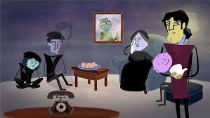
Who is the mourner?
The obligated mourner is one of seven relationships - mother, father, son, daughter, brother, sister or spouse.
Other relationships can choose to mourn but are not chayav under Jewish law.

Slide 11
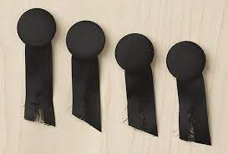
Rituals for the mourner at funeral
1. Performing the ritual of k’riah (tearing)
2. Taking over the role of shomer / shomrim from the funeral home shomer
3. Putting the first shovels of dirt in the grave – often beginning with the shovel upside down to signify how difficult it is
4. Walking between two rows of comforters at end of funeral

Slide 12
Rituals for mourner after funeral
1.Washing of hands (At cemetery and / or before entering the house after funeral)
2.Covering mirrors
3.Lighting a 7 day candle
4. Sitting shiva – making decisions about which observances you will keep
5. Meal of condolence
6. Saying kaddish

Slide 13
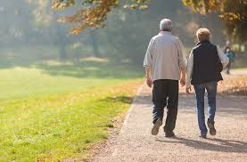
At the end of shiva…
Taking a walk…out one door and enter back in through another

Slide 14
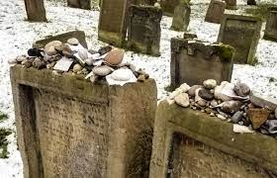
Remembering the deceased…
Visiting grave: Many people visit the grave on a significant date or before a special lifecycle moment.
Unveiling: A service that takes place sometime after the shloshim and usually before the Yahrzeit when the stone is officially dedicated at the gravesite.
Yahrzeit Candle: The candle that lasts at least 24 hours and burns in the home of the mourner during the Yahrzeit and many people light it for Yizkor.

Slide 15
Time Periods for the Mourner
Aninut: The status of mourner from the moment that they hear of the death of their loved one until the funeral.
Shloshim: This is the 30 day period from the day of the funeral. One begins to re-enter normal life. Ex. they may return to work. However, most choose to limit activities to honour the memory of the deceased.
Shana: The one-year time period when the mourner is says kaddish. Many people hold to an 11 month period for saying kaddish.
Yahrzeit: From German meaning “year time”. -the anniversary of death. This is often marked according to the Hebrew calendar, but some observe the Gregorian calendar date. One traditionally lights a yahrzeit candle that burns for 24 + hours.
Yizkor: The service of memory or remembrance held on Yom Kippur, Shemini Atzeret and the last days of Pesach and Shavuot.
Aveilut: The status of mourner from funeral until end of shiva. During shiva, the community looks after their needs, there are many traditional customs that they may observe.

Slide 16
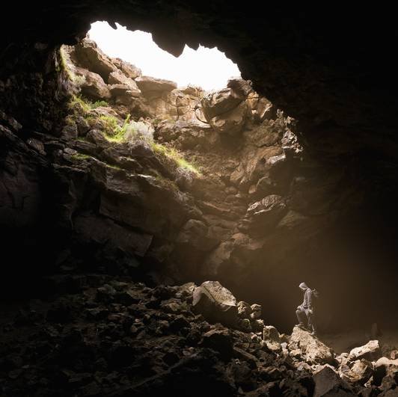
Climbing out of the darkness…
From death back to life
From sadness to gratitude
From complicated and difficult relationships to a place of understanding and comfort

Slide 17
Questions about the funeral:
1. Who can be a pallbearer?
2. Who delivers the chesped / eulogy?
3. Burial of limbs and other parts?
4. Memorial gifts?

Slide 18
What do I do if I am making a shiva call?

Slide 19
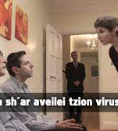
Shiva Etiquette
1. There are no clothing rules – something respectful
2. Don’t ring doorbell – walk right in
3. If you don’t know all of the mourners you can often tell by seeing the k’riah ribbon
4. Be present – often wait for the mourners to initiate conversation
5. Shiva is not a party
6. If it is evening, do not stay late, the mourners are exhausted
7. Take your leave with the line, “May God comfort you amongst all the mourners of Zion and Jerusalem”

Slide 20
Questions the mourner needs to answer:
1. What can I do during shiva / shloshim / year?
2. Who says kaddish?
3. What do I do about a joyous occasion during shloshim?
As a Jew of choice, how do I mourn for my non-Jewish family members?

Slide 21
What does Judaism say about the afterlife?

Slide 22
There is no single belief or theology!

Slide 23
The afterlife can take many forms:
Professor A.J. Levine
“Jewish beliefs in the afterlife are as diverse as Judaism itself, from the traditional view expecting the unity of flesh and spirit in a resurrected body, to the idea that we live on in our children and grandchildren, to a sense of heaven (perhaps with lox and bagels rather than harps and haloes).”

Slide 24
In Tanakh and Talmud
In the Tanakh there is an underworld called Sheol. It is described mostly as a dark pit and everyone goes there.
In the rabbinic tradition it’s known by a number of names, including the yeshiva shel mallah, the school on high and Olam HaBa.
The Hebrew word for skies, shamayim, also came to refer to heaven.

Slide 25
Heaven is open to all
The righteous of any people and any faith have a place in it. Our actions, not our specific beliefs, determine our fate.
No concept of Hell exists in Judaism. The closest we get is the fate of apostate (a person who renounces God, faith and morality in this world), who is said to be “cut off from his kin.”

Slide 26
The afterlife is here on earth
One strand of Jewish thought sees heaven as a transitory place where souls reside after death. They reside there until they reunite with their physical bodies at the time when the Moshiach comes.
This approach differs from reincarnation since the return to life happens only in the messianic era, not as a regular occurrence, as in Hinduism.

Slide 27
We live on through others:
The Reform Jewish prayerbook expresses this idea through the metaphor of a leaf and a tree. A leaf drops to the ground, but it nourishes the soil so more plants and trees spring up.
The same is true in our lives. We nourish the future through the influence we have on those who follow us. It can happen in unimaginable ways.

Slide 28
The Mourner’s Kaddish
יִתְגַּדַּל וְיִתְקַדַּשׁ שְׁמֵהּ רַבָּא. בְּעָלְמָא דִּי בְרָא כִרְעוּתֵהּ, וְיַמְלִיךְ מַלְכוּתֵהּ בְּחַיֵּיכוֹן וּבְיוֹמֵיכוֹן וּבְחַיֵּי דְכָל בֵּית יִשְׂרָאֵל, בַּעֲגָלָא וּבִזְמַן קָרִיב, וְאִמְרוּ אָמֵן.
יְהֵא שְׁמֵהּ רַבָּא מְבָרַךְ לְעָלַם וּלְעָלְמֵי עָלְמַיָּא.
יִתְבָּרַךְ וְיִשְׁתַּבַּח וְיִתְפָּאַר וְיִתְרוֹמַם וְיִתְנַשֵּׂא וְיִתְהַדָּר וְיִתְעַלֶּה וְיִתְהַלָּל שְׁמֵהּ דְּקֻדְשָׁא בְּרִיךְ הוּא, לְעֵֽלָּא מִן כָּל בִּרְכָתָא וְשִׁירָתָא תֻּשְׁבְּחָתָא וְנֶחֱמָתָא, דַּאֲמִירָן בְּעָלְמָא, וְאִמְרוּ אָמֵן.
יְהֵא שְׁלָמָא רַבָּא מִן שְׁמַיָּא, וְחַיִּים עָלֵֽינוּ וְעַל כָּל יִשְׂרָאֵל, וְאִמְרוּ אָמֵן.
עֹשֶׂה שָׁלוֹם בִּמְרוֹמָיו, הוּא יַעֲשֶׂה שָׁלוֹם עָלֵֽינוּ וְעַל כָּל יִשְׂרָאֵל, וְאִמְרוּ אָמֵן.

Slide 29
Mourner’s Kaddish – What does it mean?
Exalted and hallowed be God’s great name in the world which God created, according to plan.
May God’s majesty be revealed in the days of our lifetime and the life of all Israel - speedily, imminently, to which we all say Amen.
Blessed be God’s great name to all eternity. Blessed, praised, honoured, exalted, extolled, glorified, adored, and lauded be the name of the Holy Blessed One, beyond all earthly words and songs of blessing, praise, and comfort. To which we say Amen.
May there be abundant peace from heaven, and life, for us and all Israel, to which we say, Amen. May the One who creates harmony on high, bring peace to us and to all Israel. To which we say, Amen.

Slide 30
Mourner’s Kaddish for Everyday by Debra Cash
Build me up of memory
Loving and angry, tender and honest.
Let my loss build me a heart of wisdom,
Compassion for the world’s many losses.
Each hour is mortal
And each hour is eternal
And each hour is our testament
May I create worthy memories all the days of my life.

Slide 31
Books for further study:
Maurice Lamm, The Jewish Way in Death and Mourning
Anita Diamant, Saying Kaddish: How to Comfort the Dying, Bury the Dead and Mourn as a Jew

